Slide 1

ScamGPT: An Intelligent System for Scam Detection and Educational Intervention
Introducing ScamGPT, an AI solution designed to detect scams instantly. It combines cutting-edge technology with user education to tackle the $10.3 billion lost to scams in 2023. Empower yourself to stay safe in digital communications.
by
Sk.Afeef Sameen
22STUCHH010426

Slide 2

Problem: The Pervasive Landscape of Digital Scams
Rising Scam Frequency
Scams soar across email, SMS, and social media platforms.
Phishing Surge
Phishing attacks jumped 61% in 2023, APWG reports.
Detection Limitations
Many current tools miss evolving scams, leaving gaps.
User Awareness Gap
Lack of education increases victim vulnerability.

Slide 3

Solution: ScamGPT’s Multifaceted Approach
ScamGPT is an AI-powered system that detects scams instantly.
It combines advanced technology with user education for prevention.
This approach improves scam detection and empowers users to stay safe.

Slide 4





Solution: ScamGPT’s Multifaceted Approach
Real-Time Detection
Instantly flags suspicious messages as they appear.
NLP Analysis
Decodes message language to identify scam content.
Machine Learning
Trained on millions of scam examples for accuracy.
Behavioral Patterns
Detects anomalies signaling potential fraud.

Slide 5
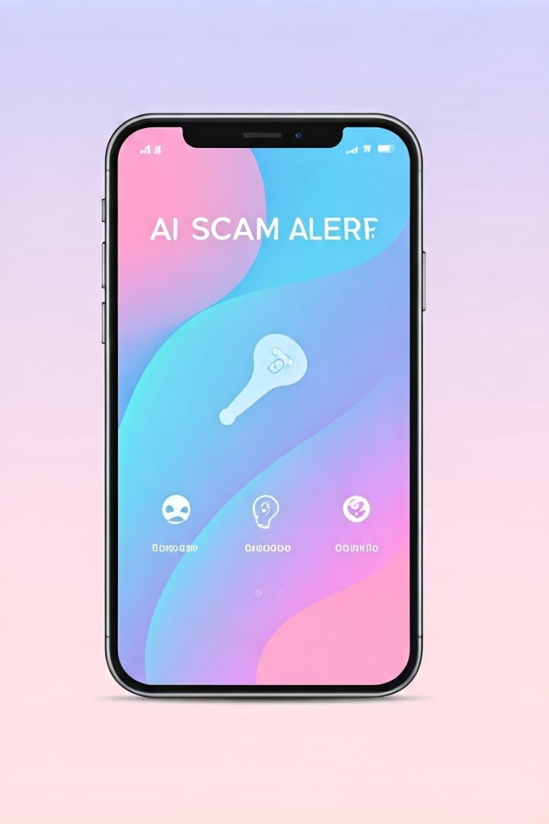




ScamGPT's Key Features and Functionalities
Real-Time Detection
Educational Intervention
Scam Type Identification
Flags scams as messages arrive to prevent harm.
Explains scam tactics to increase user knowledge.
Classifies phishing, romance, investment scams, and more.
User-Friendly Interface
Integrates seamlessly into popular communication apps.

Slide 6
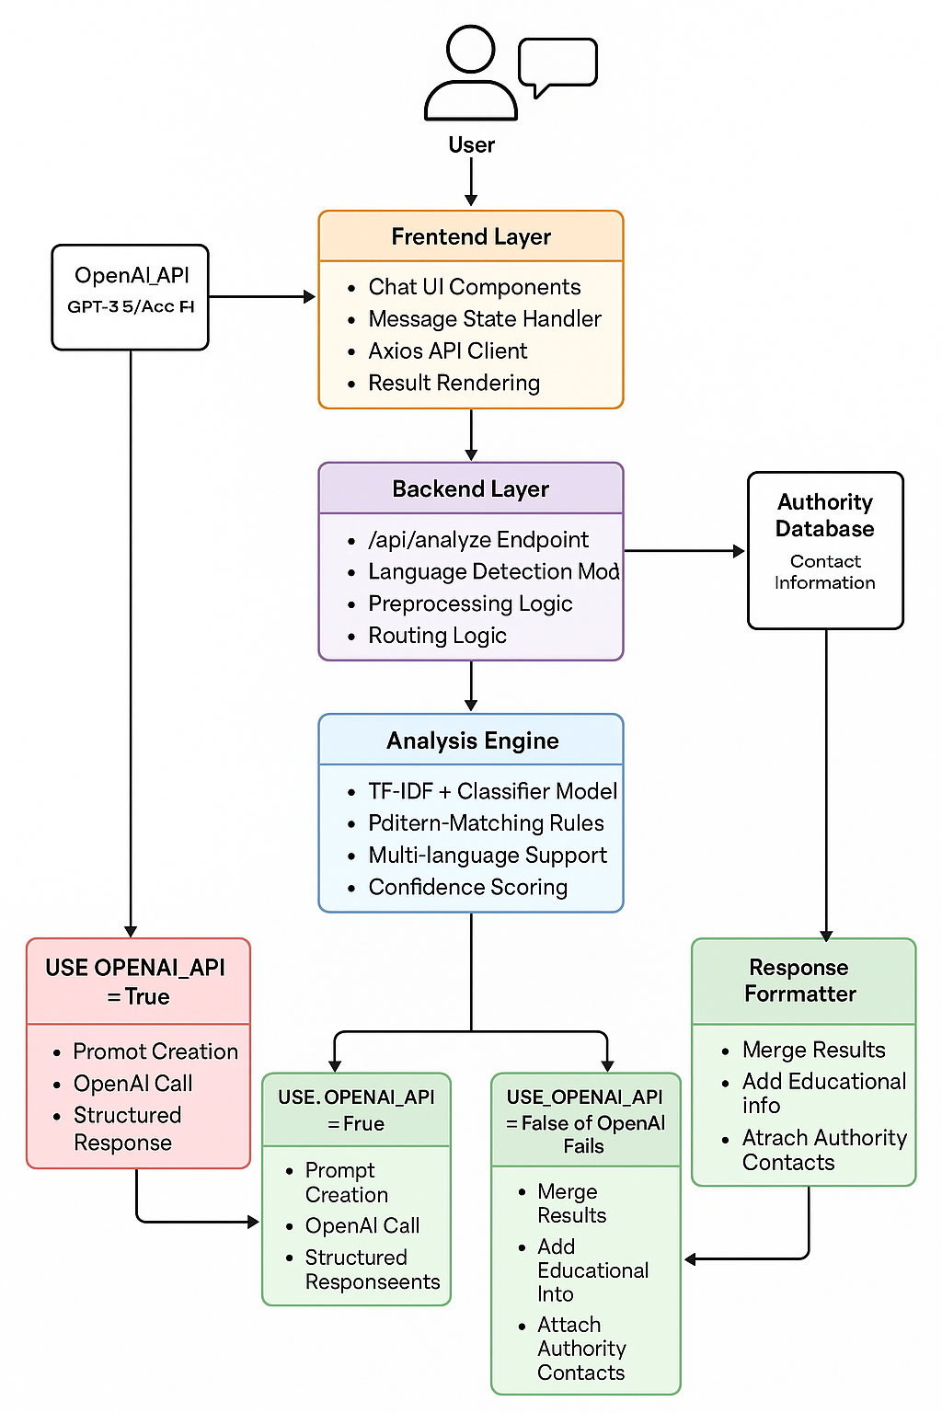
System Architecture
Frontend (React.js)
Chat UI, API requests, displays results
Backend (Flask API)
Handles requests, preprocessing, routing
Analysis Engine
ML model + pattern matching, multi-language support
OpenAI Integration
GPT-3.5/4 for enhanced scam analysis
Authority Database
Regional reporting contacts and guidelines
Response Formatter
Combines results, adds guidance, sends reply

Slide 7

Technology stack
frontend : React , Javascript,CSS, Axios
Backend : Python 3.8 ,Flask 2.0.1 and other ML libraries
API Integration : OpenAI API
Development Tools : VsCode,Github,ChatGPT
.
.
.

Slide 8





Impact and Benefits: Empowering Users and Reducing Fraud
Educational Empowerment
Financial Protection
Trust Building
Wide Scalability
Reduces losses and prevents identity theft.
Enhances security in daily communication.
Benefits individuals, companies, and entire communities.
Users gain knowledge to recognize scams effectively.

Slide 9

Future Directions and Call to Action
Get Involved
Strengthen Partnerships
Join the fight against scams. Download ScamGPT today!
Personalized Learning
Collaborate with law enforcement and cybersecurity bodies.
Expand Platforms
Develop customized education based on user profiles.
Extend ScamGPT to more apps and languages.

Slide 10
ScamGPT Interface Overview
Real-Time Alerts
Educational Popups
User Dashboard
Interface provides instant scam warnings as messages appear.
Interactive explanations help users understand scam tactics.
Clear summary of threats detected and learning progress.

Slide 11
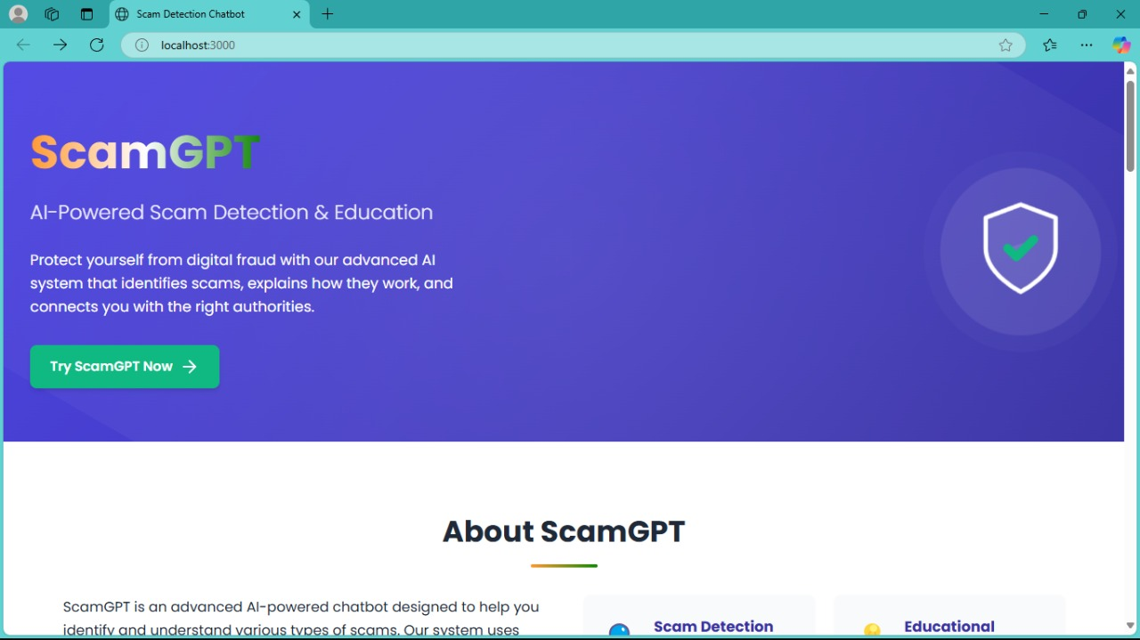
ScamGPT in Action

Slide 12
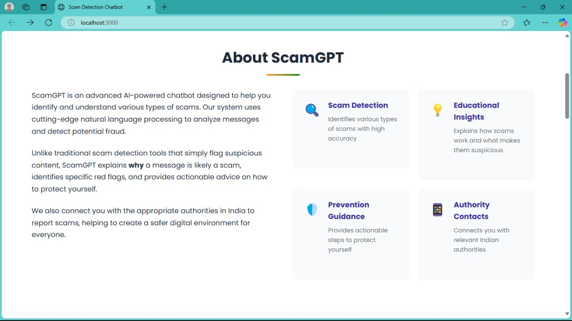

Slide 13
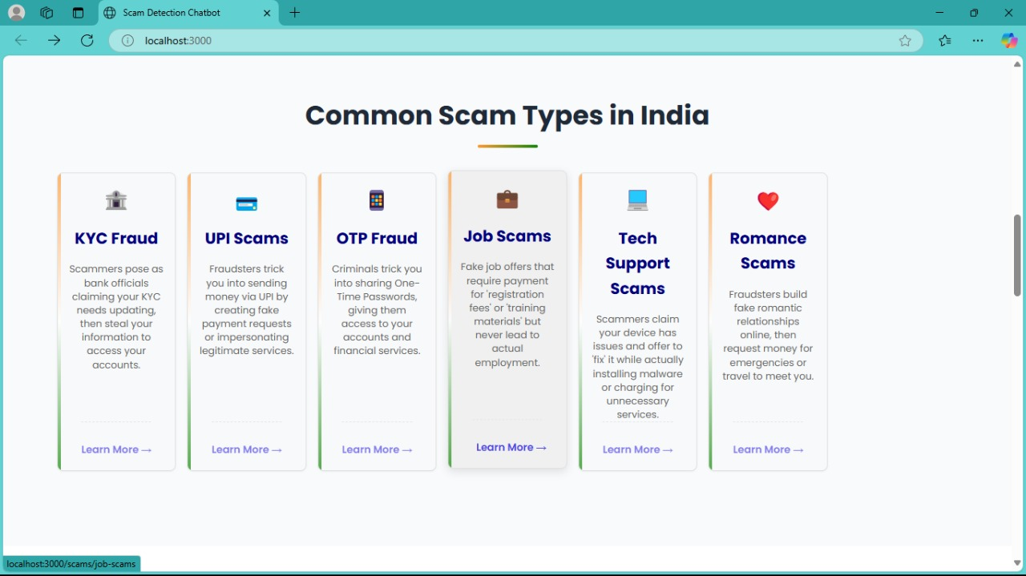

Slide 14
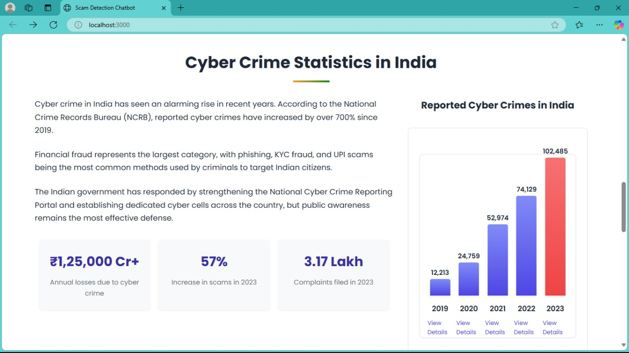

Slide 15
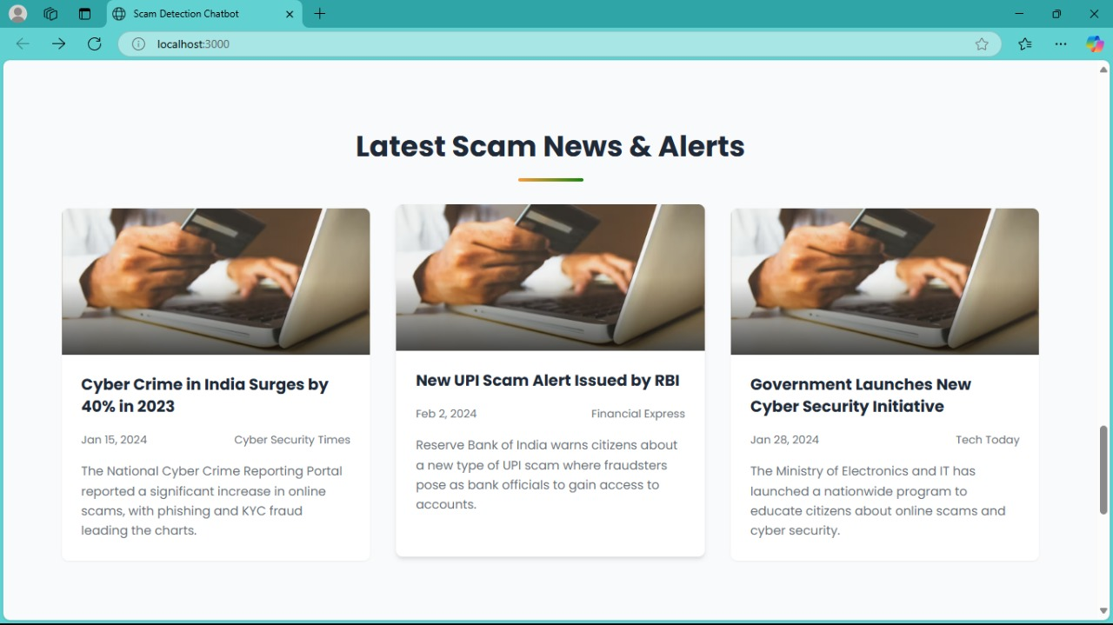

Slide 16
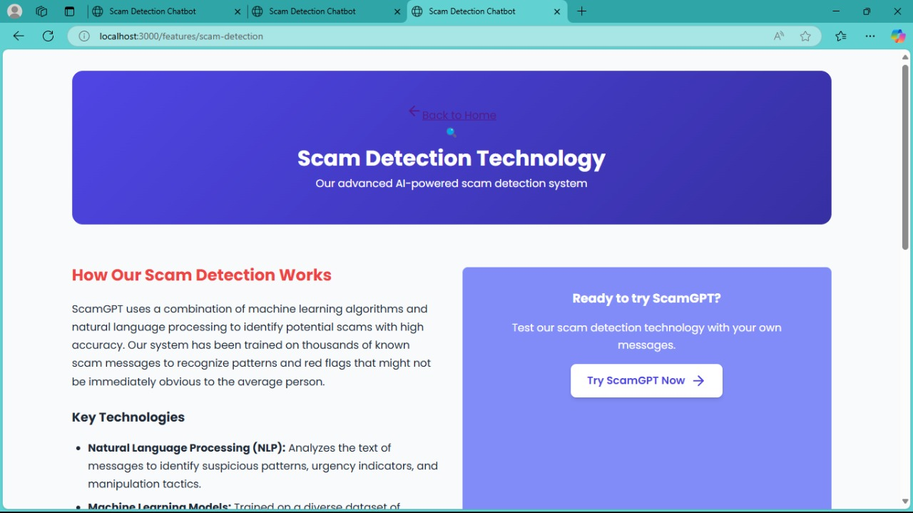
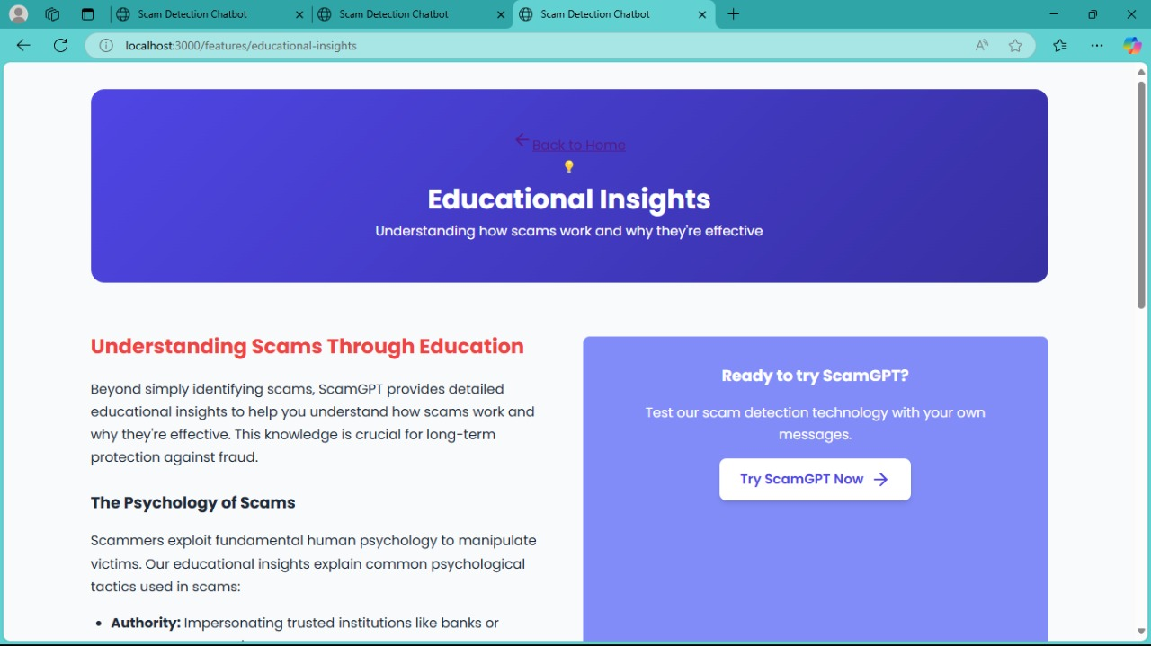

Slide 17
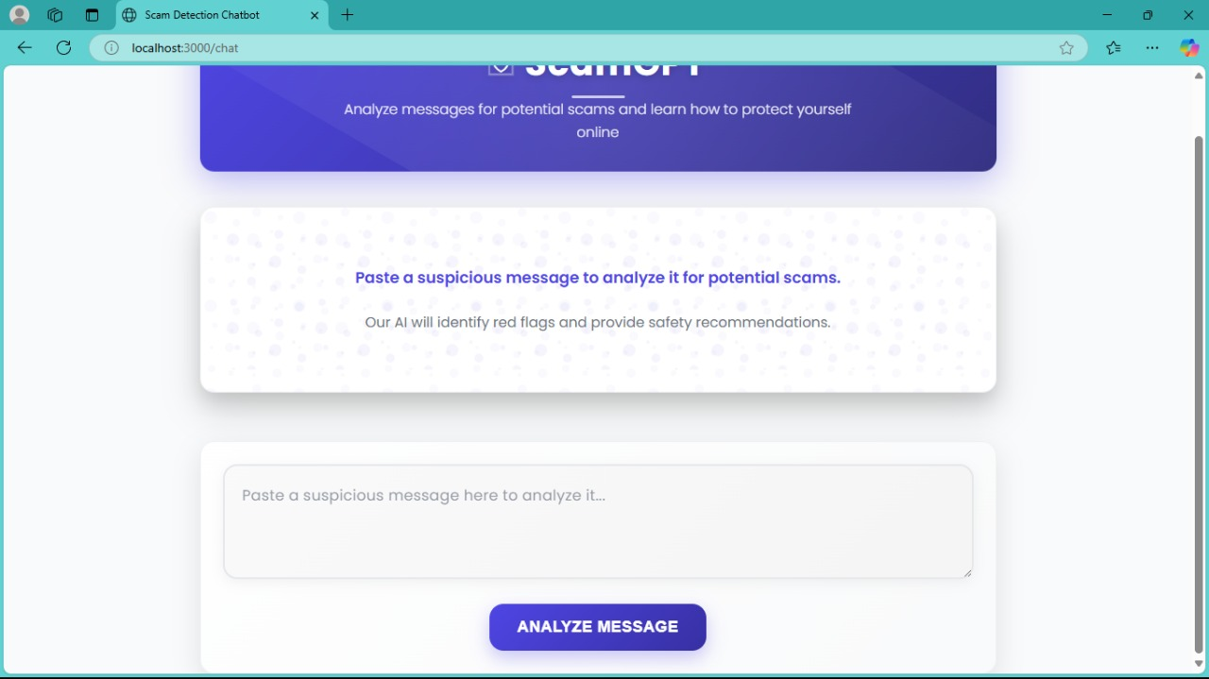

Slide 18
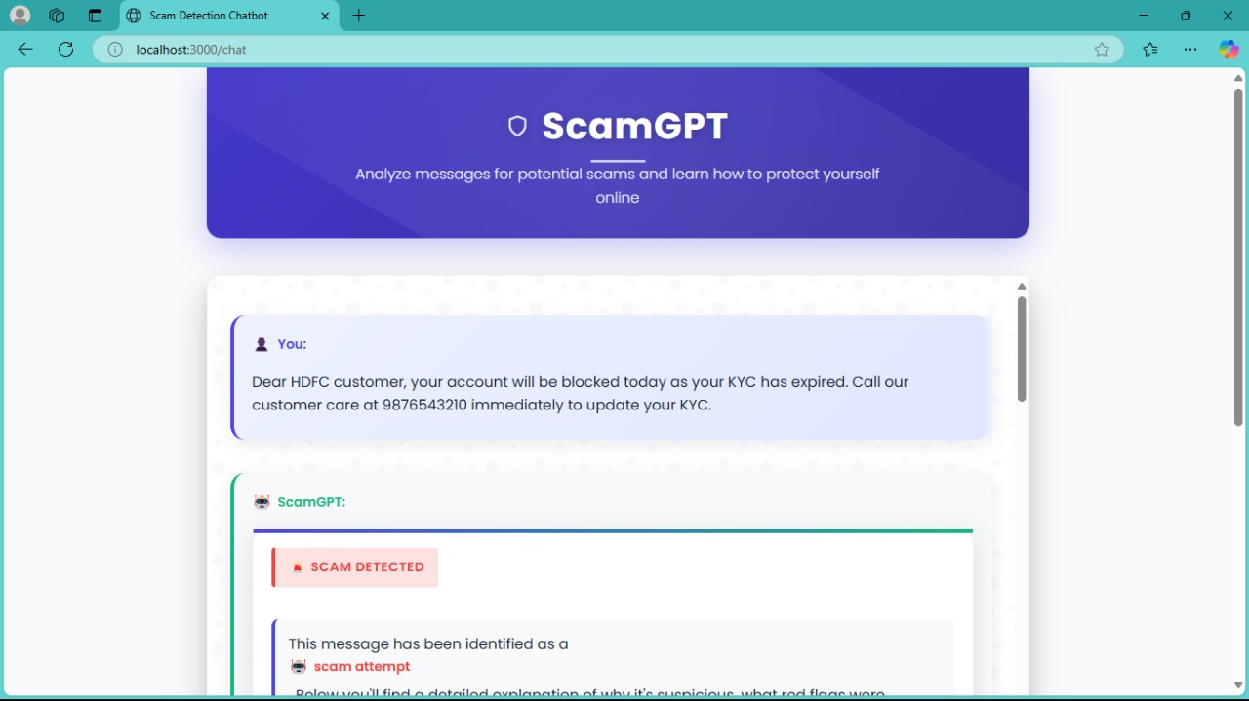

Slide 19
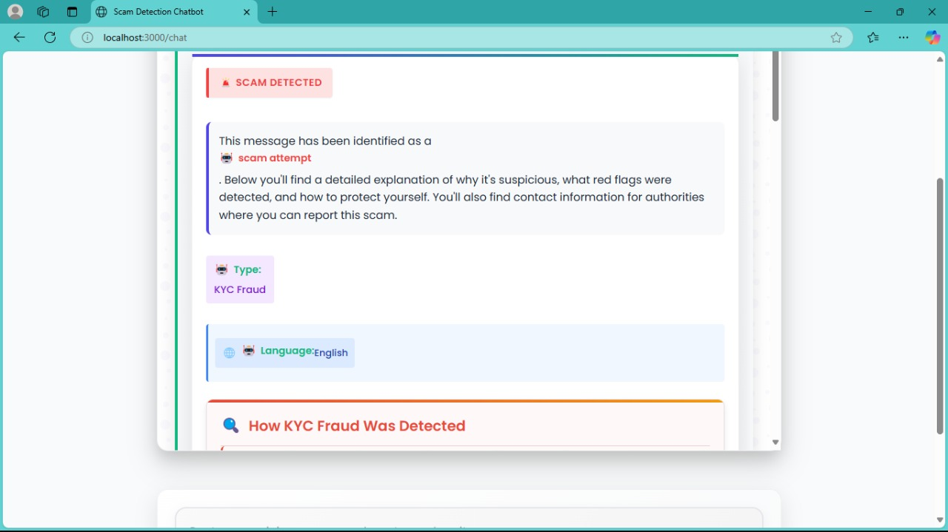

Slide 20
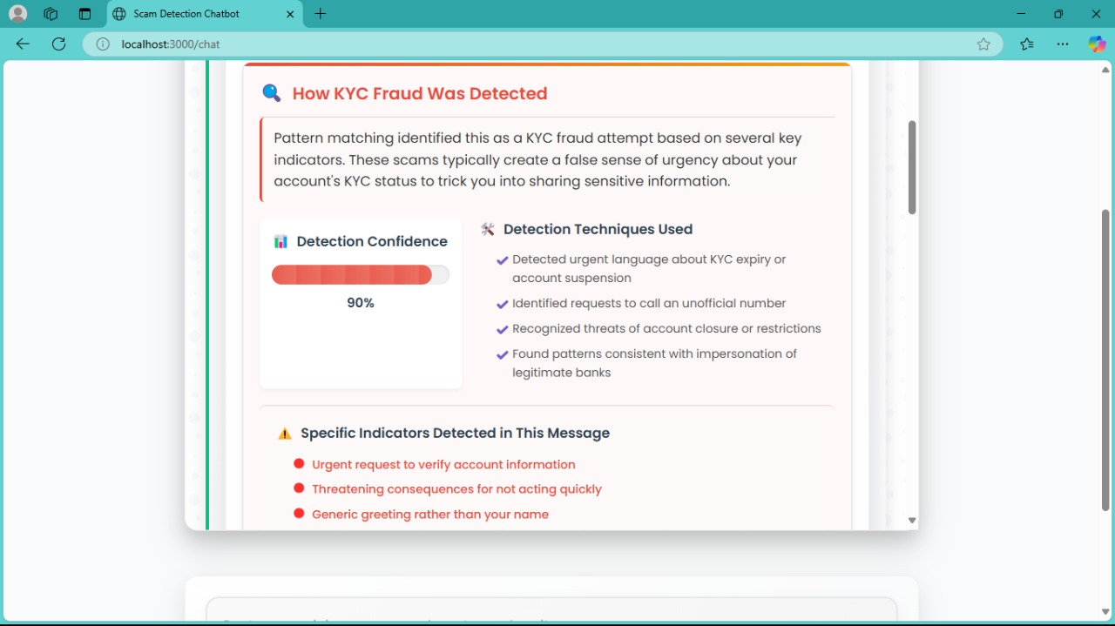

Slide 21
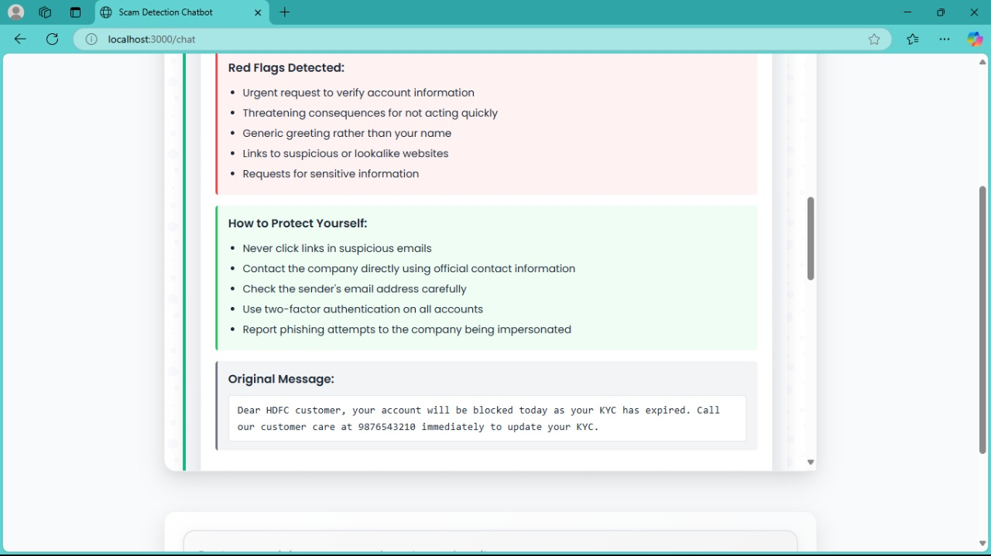

Slide 22
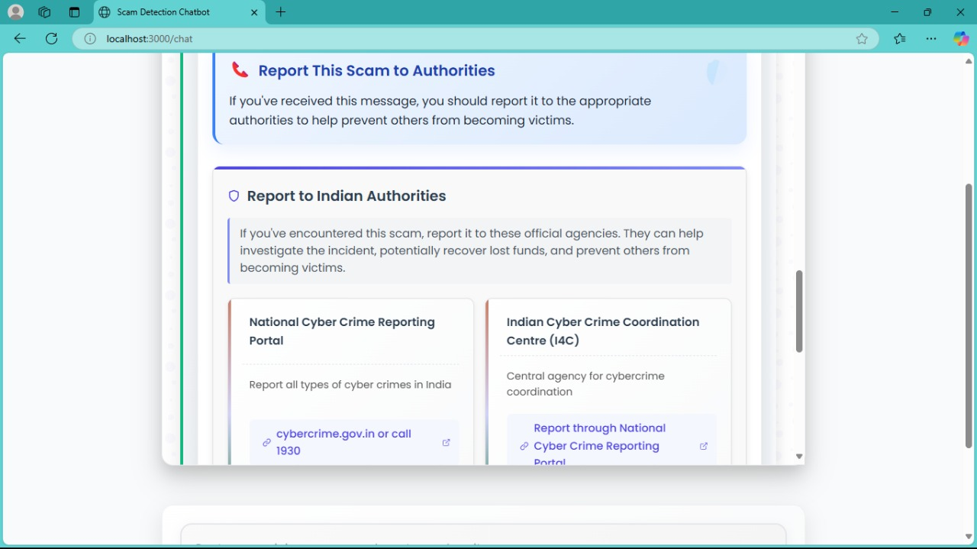

Slide 23
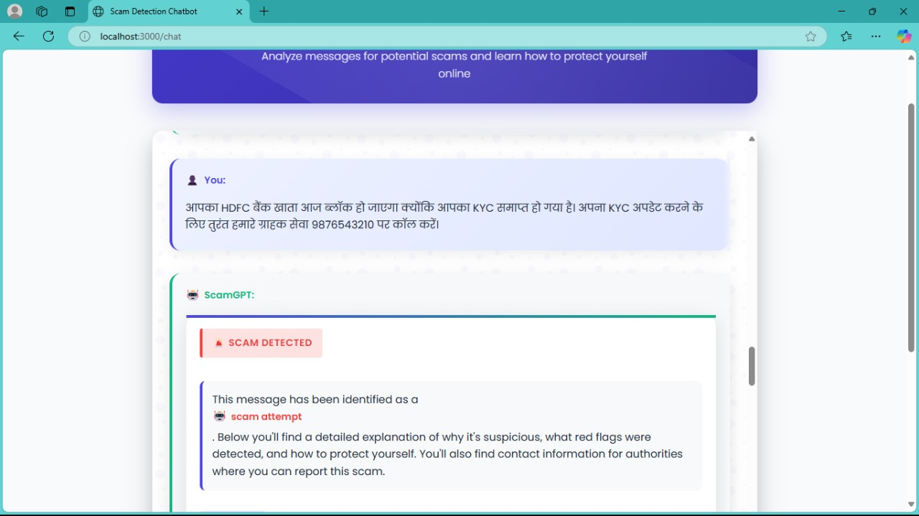

Slide 24
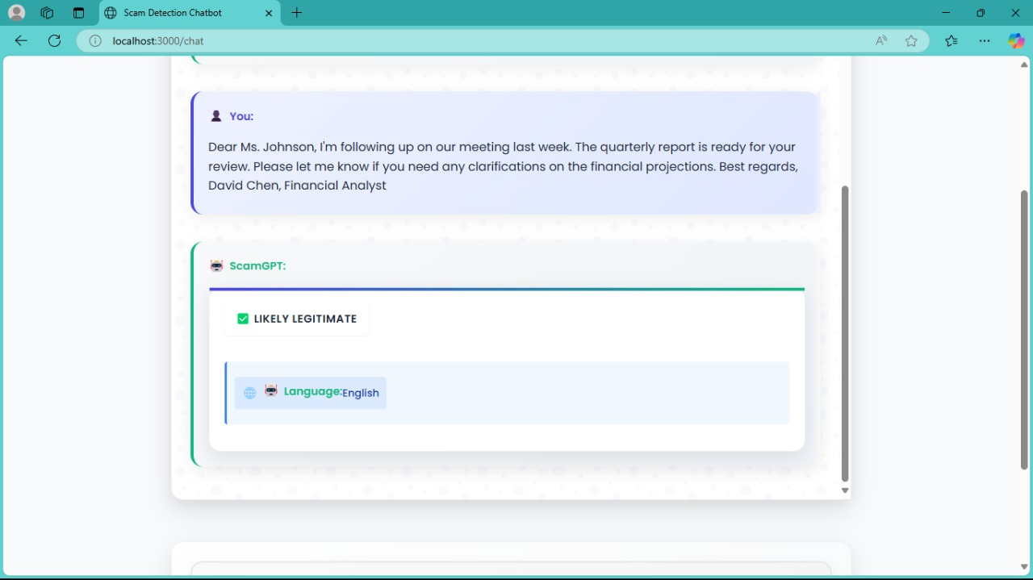

Slide 25


